Slide 1
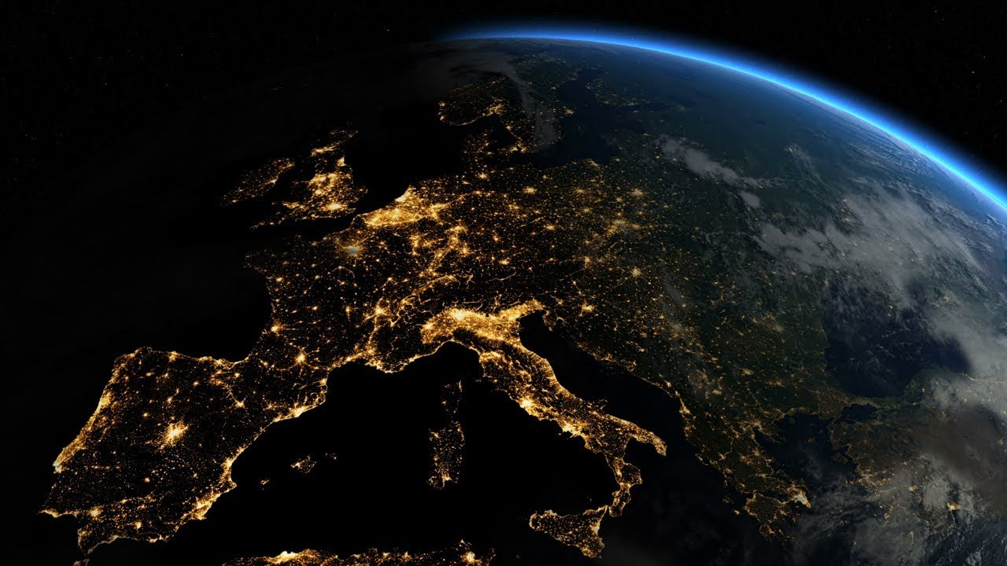
SPACE
The concept of space is about the way things are arranged and located on the earth’s surface. It has three main elements:
Location - where things are located on the Earth’s surface. (absolute location/relative location)
Spatial distribution – the shapes and patterns in which things are arranged on the earth’s surface.
Organisation - how the space is organised and managed by people
E.g. Where is your landform located on the Earth’ s surface?

Slide 2
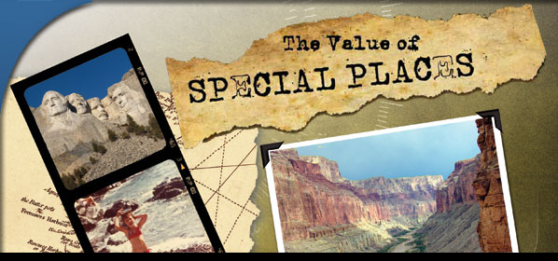
PLACE
The concept of place is about the significance of places and what they are like. Your home and your school are important places for you because they are the places where you live and spend most of your time. A place can be as small as your bedroom or as large as the entire planet!
E.g. What is special or unique about the landform you are researching?

Slide 3

INTERCONNECTION
No place or thing on Earth exists in isolation. Interconnection is the ways that the people and things are connected with each other, and the consequences of these interconnections.
E.g: How do people connect with you’re your landform?

Slide 4
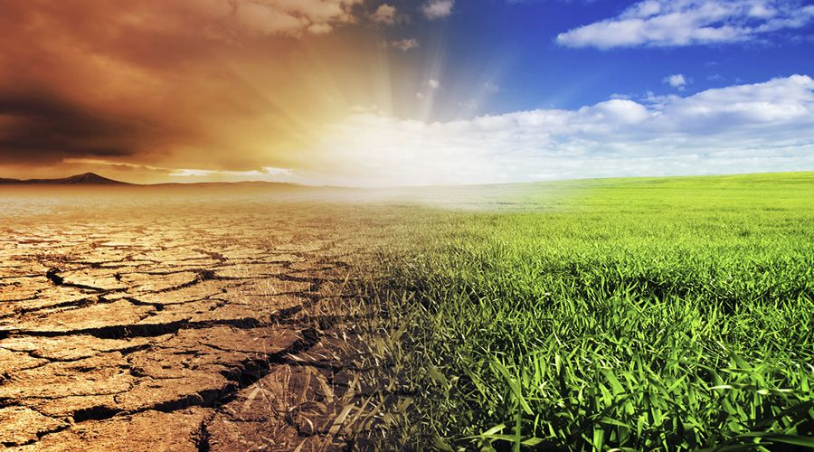
CHANGE
Over millions of years, the Earth has been shaped and changed by natural forces, such as climate, earthquakes, volcanoes, running water and storms. In more recent times, humans have shaped and changed the Earth to suit their own needs.
Change is about investigating how places and spatial patterns change over time in the short and long term.
E.g. How has your landform changed overtime and how is it still changing?

Slide 5
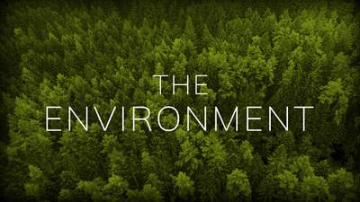
ENVIRONMENT
The concept of environment is about how people rely on, use and change the physical and biological world around us.
E.g. What type of environment is your landform located in and how is the environment used?

Slide 6

SUSTAINABILITY
Sustainability is using the environment and resources so they can be shared by all people and living creatures now and into the future.
E.g. What sustainability measures are being used to protect your landform now and into the future?

Slide 7

SCALE
The concept of scale is about the way that geographical phenomena and problems can be examined at different spatial levels – local, regional, national, international or global.
For example:
The Earth’s climate is warming – Global problem
A new freeway is being built through the city – Local issue
An earthquake is destroying a town in Italy – National
E.g. What are some of the issues related to your landform and at what level can they be examined or addressed?

